Slide 1
Theatre Arts
Vocabulary List #5

Slide 2
September 11 – 15, 2017
catharsis The purification or purgation of the emotions (as pity and fear) caused in a tragedy.
commedia dell'arte A professional form of theatrical improvisation, developed in Italy in the 1500s, featuring stock characters and standardized plots.
creative drama An improvisational, process-centered form of theatre in which participants are guided by a leader to imagine, enact, and reflect on human experiences.

Slide 3
September 11 – 15, 2017
crisis A decisive point in the plot of a play on which the outcome of the remaining actions depends.
denoument design The final resolution of the conflict in a plot.
Elizabethan theatre The theatre of England during the reign of Queen Elizabeth I and often extended to the close of the theatres in 1640.

Slide 4
September 11 – 15, 2017
epic theatre Theatrical movement of the early 1920s and 1930s characterized by the use of such artificial devices as cartoons, posters, and film sequences distancing the audience from theatrical illusion and allowing focus on the play's message.
farce A comedy with exaggerated characterizations, abundant physical or visual humor, and, often, an improbable plot.
formal theatre Theatre that focuses on public performance in front of an audience and in which the final production is most important.

Slide 5
September 11 – 15, 2017
Greek theatre Theatrical events in honor of the god Dionysus that occurred in Ancient Greece and included play competitions and a chorus of masked actors.
informal theatre A theatrical performance that focuses on small presentations, such as one taking place in a classroom setting. Usually, it is not intended for public view.
Kabuki One of the traditional forms of Japanese theatre, originating in the 1600s and combining stylized acting, costumes, makeup, and musical accompaniment.

Slide 6
September 11 – 15, 2017
melodrama A dramatic form popular in the 1800s and characterized by an emphasis on plot and physical action (versus characterization), cliff-hanging events, heart-tugging emotional appeals, the celebration of virtue, and a strongly moralistic tone.
mime An ancient art form based on pantomime in which conventionalized gestures are used to express ideas rather than represent actions; also, a performer of mime.
minstrel show Musical theatre that usually consisted of performances of traditional African-American music and dance provided by white actors in blackface and characterized by exploitive racial stereotypes.

Slide 7
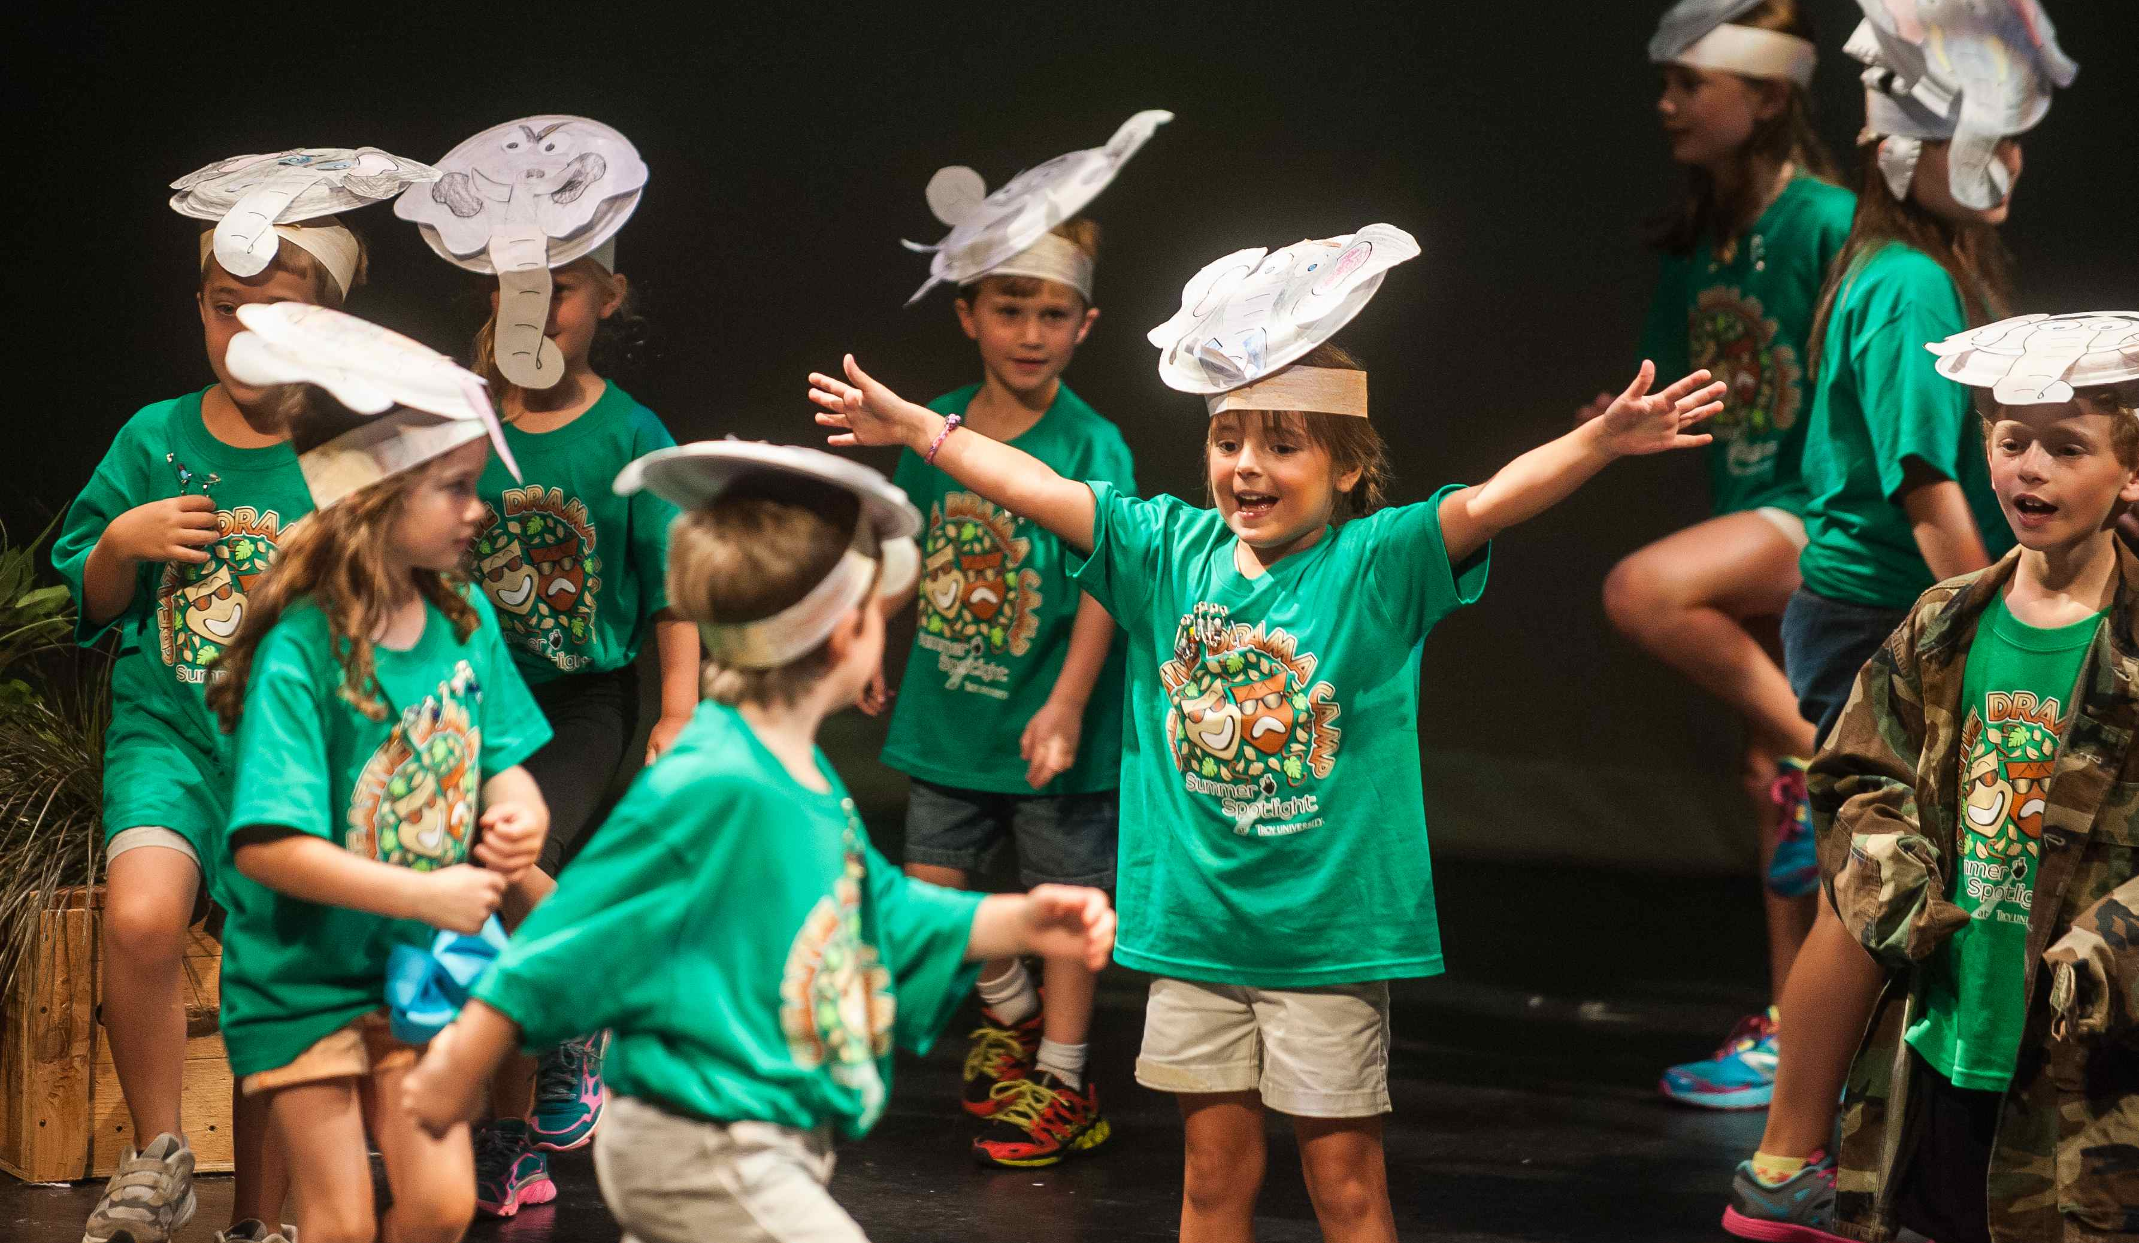
Creative Drama

Slide 8
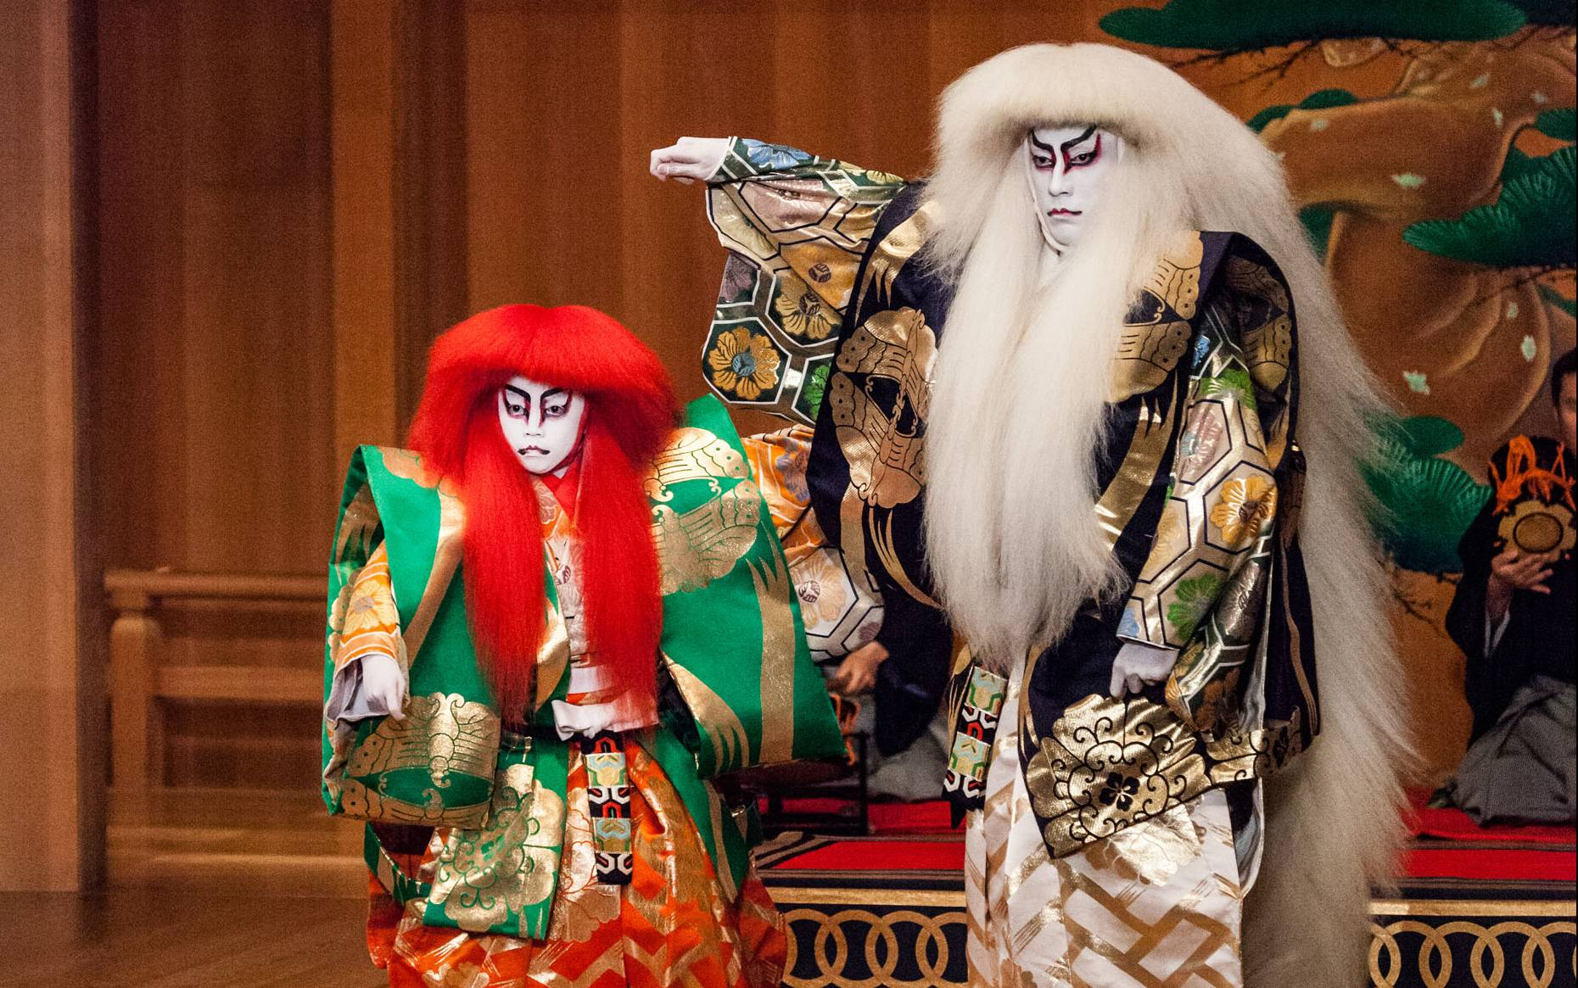
Kabuki

Slide 9
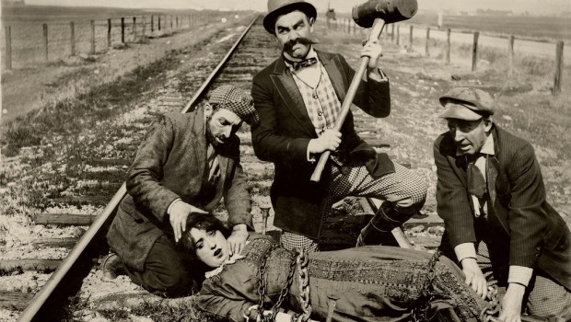
Melodrama

Slide 10
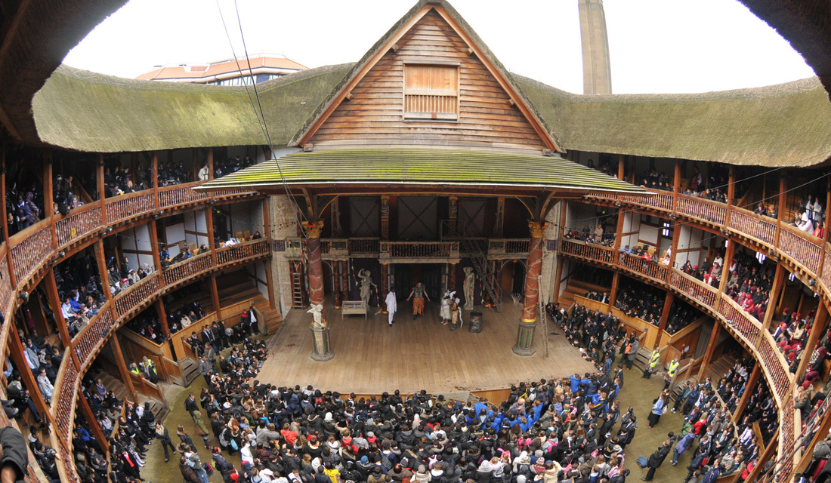
Elizabethan Theatre

Slide 11
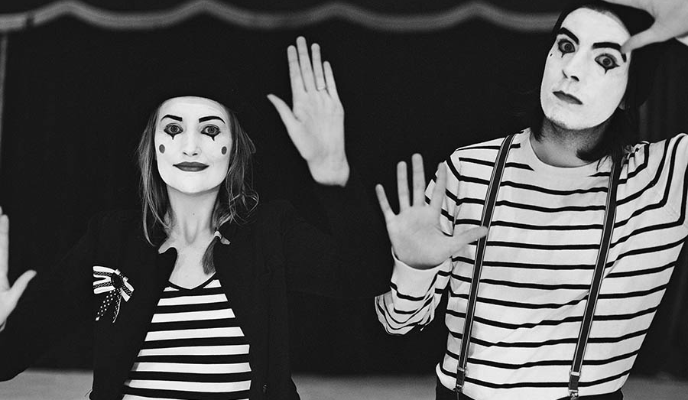
Mime

Slide 12
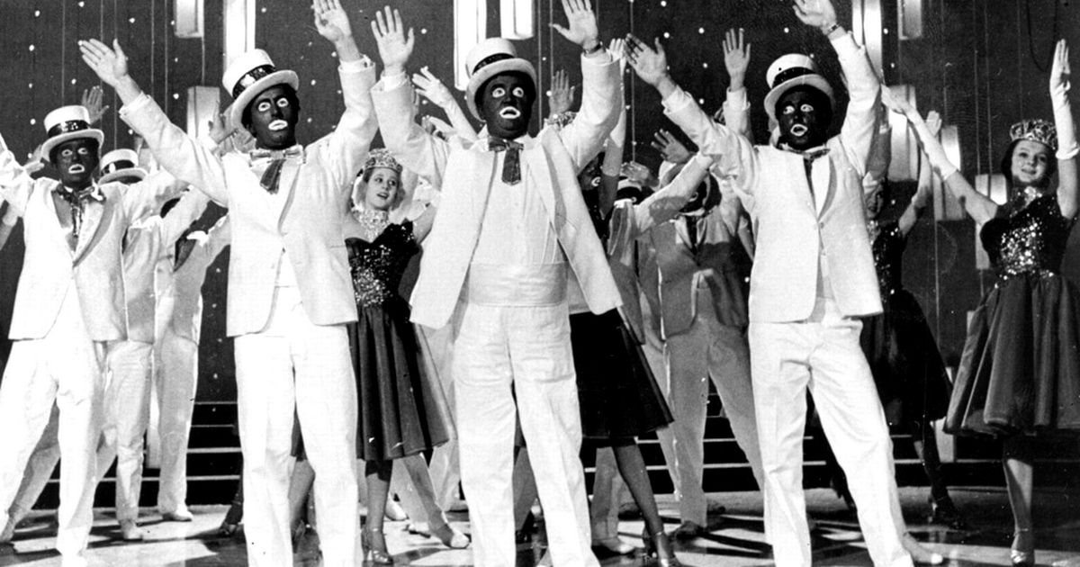
Minstrel Show

Slide 13
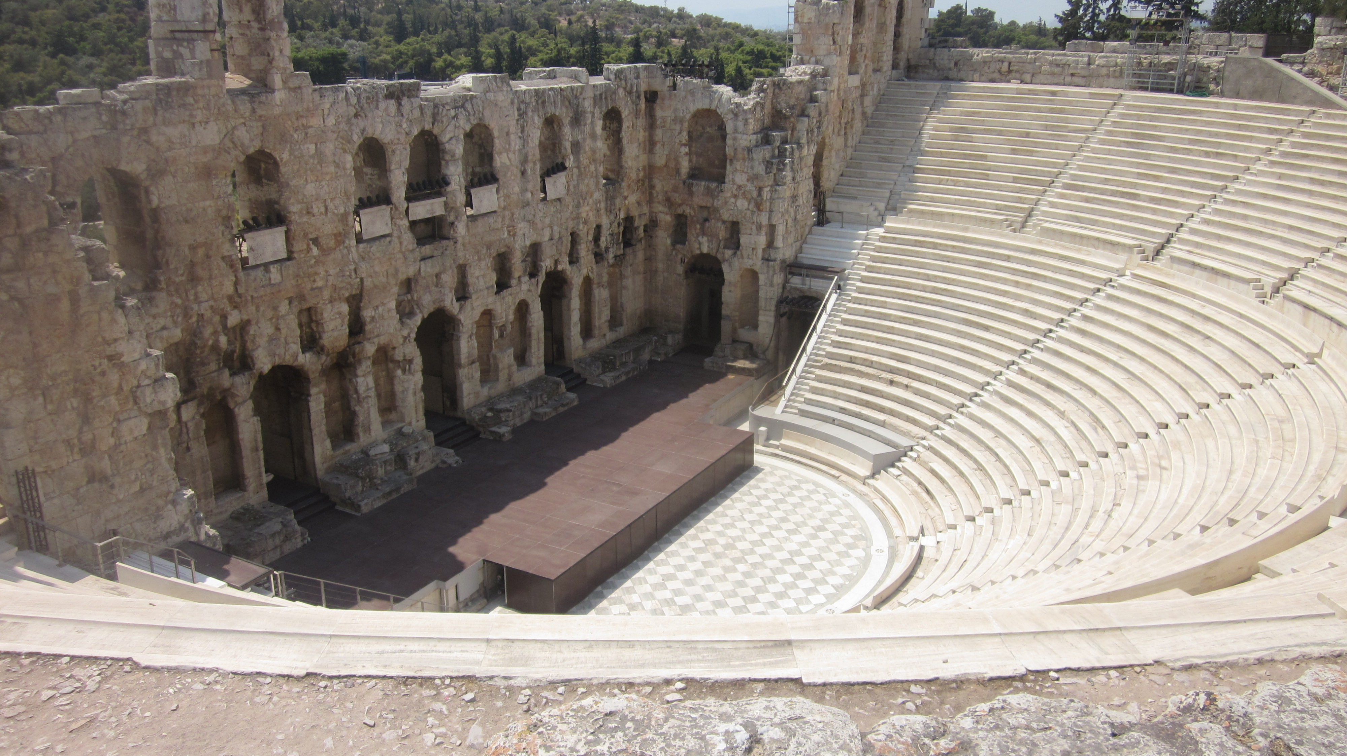
Greek Theatre

Slide 14
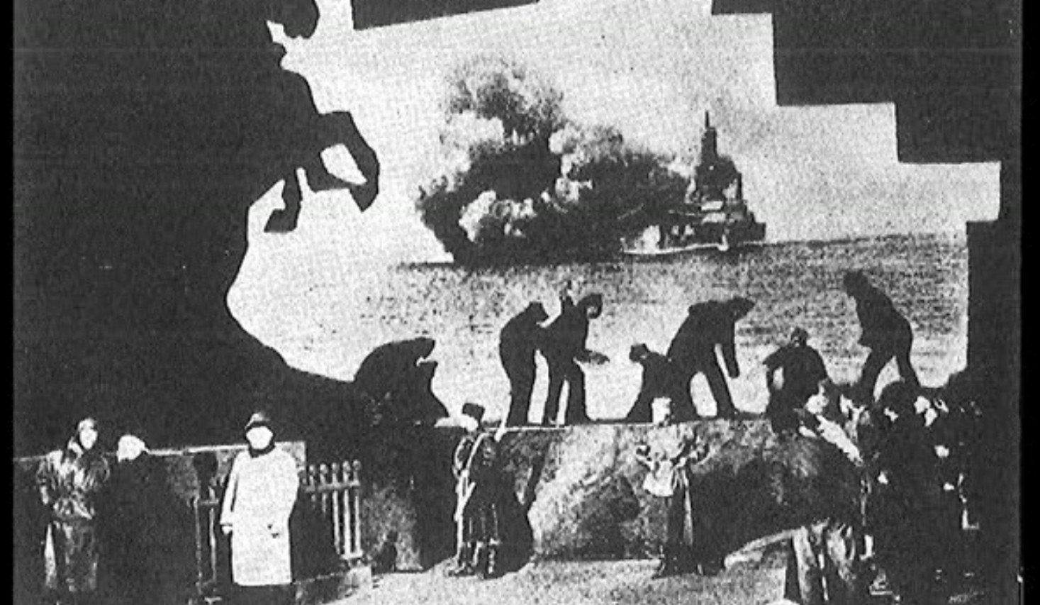
Epic Theatre

Slide 15
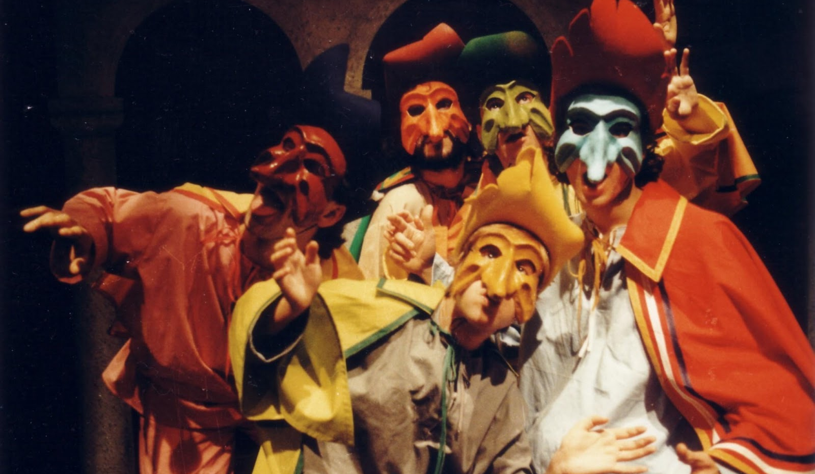
Commedia dell’Arte

Slide 16
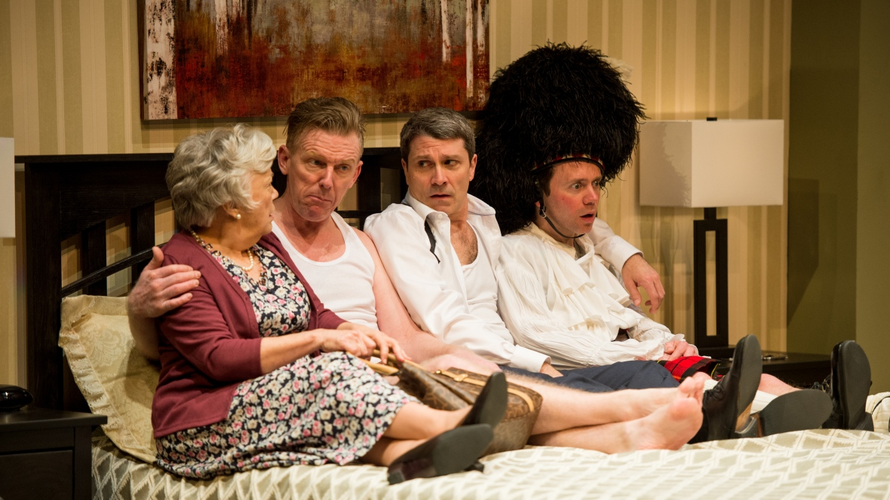
Farce

Slide 17
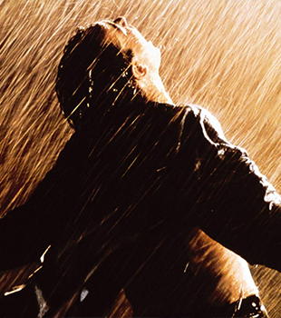
Catharsis
The process of releasing, and thereby providing relief from strong or repressed emotions.
The purging of the emotions or relieving of emotional tensions, especially through certain kinds of art, as tragedy or music.

Slide 18
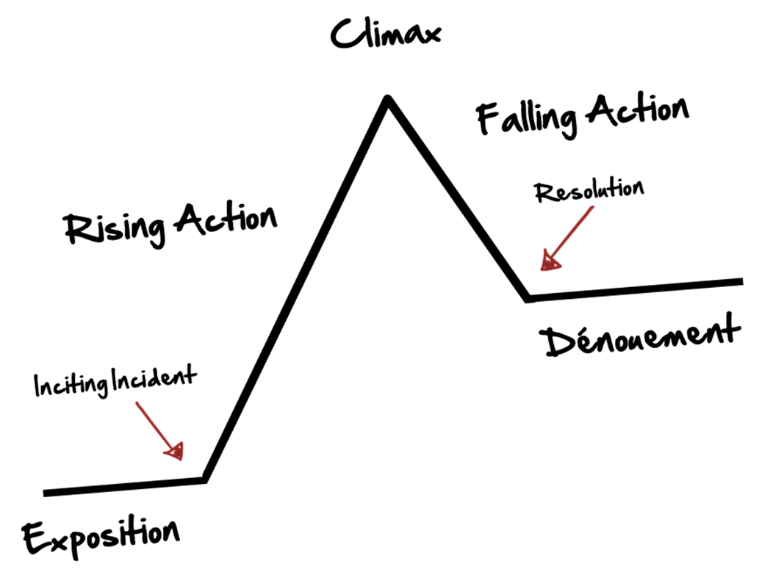
Dénouement
The final part of a story in which the strands of a plot are drawn together and matters are explained or resolved.

